Slide 1
A Service Oriented Architecture (SOA) Primer

Slide 2
Why SOA?
Modern application architectures are almost always distributed, we desire an architecture approach to construct applications using a collection of autonomous services.
Focus of design is on integration – individual services could be developed and deployed using different technology stacks and platforms. Integration patterns are selected that use messaging
Desire to reuse well known OO principles such as encapsulation, abstraction, and well-defined interfaces in creating new architectures based on SOA
Availability and stability of services influence design decisions – separate core aspects of building the service (not likely to change) from the service configuration (likely to change)
The desire to easily integrate capabilities built and hosted by others into our own applications

Slide 3
All modern systems are distributed
Challenges with Distributed Systems
Consistency
Other Problems
Architecture Patterns – this is where SOA comes in
API and Framework Considerations

Slide 4
Challenges with Distributed Systems
These are generally known as the “fallacies of distributed computing”
The network is reliable.
Latency is zero.
Bandwidth is infinite.
The network is secure.
Topology doesn't change.
There is one administrator.
Transport cost is zero.
The network is homogeneous.
http://en.wikipedia.org/wiki/Fallacies_of_distributed_computing

Slide 5
CAP Theorem – Can only pick 2

Slide 6
Other Challenges
The many nodes in a distributed system cant guarantee that they see the same ordering of events (or messages)
Nor can they agree or synchronize based on time

Slide 7
Security Challenges
Also, the various nodes in a distributed system should not trust each other

Slide 8
Unreliable Network Challenges
Client and Servers in a distributed system cannot make certain assumptions about each other
Client
?
Server
?
Did the server get my message?
Is the server slow?
Did the server die?
Is the client still there?
Did the client get my response?
These problems can be partially addressed using timeouts

Slide 9
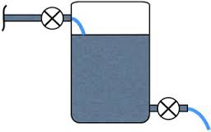
Flow Control Challenges
Client
?
Server
?
Can the client keep up with the data being returned from the server
Can the server keep up with the client volume?
These problems are dealt with using patterns like back pressure and circuit breakers

Slide 10
Architecture Styles
Service Oriented Architecture, versus
Service Based Architecture, versus
Microservices Architecture

Slide 11
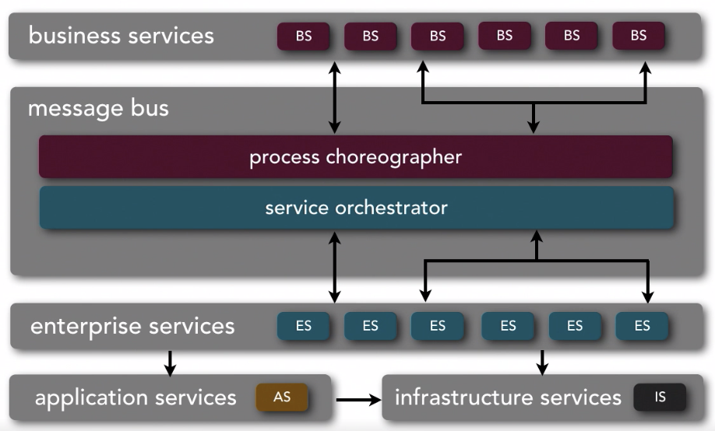
Service Oriented Architecture Style
Ref: Neil Ford & Mark Richards Software Architecture Fundamentals
Smart Middleware – Sometimes called an ESB

Slide 12
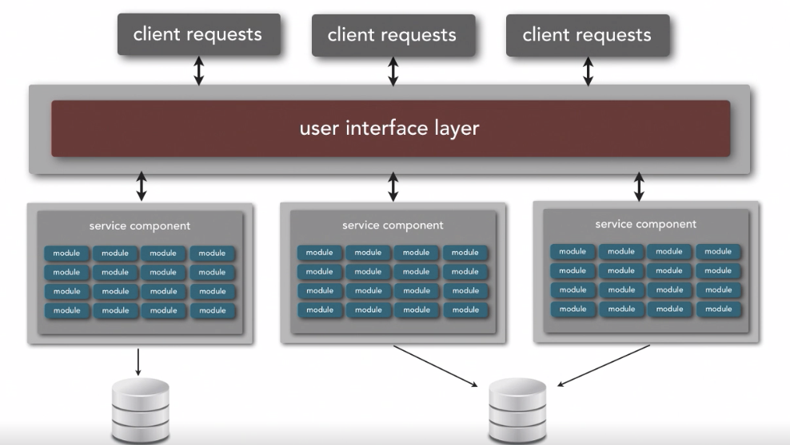
Service Based Style
Ref: Neil Ford & Mark Richards Software Architecture Fundamentals
Works Well To Partition Functionality

Slide 13
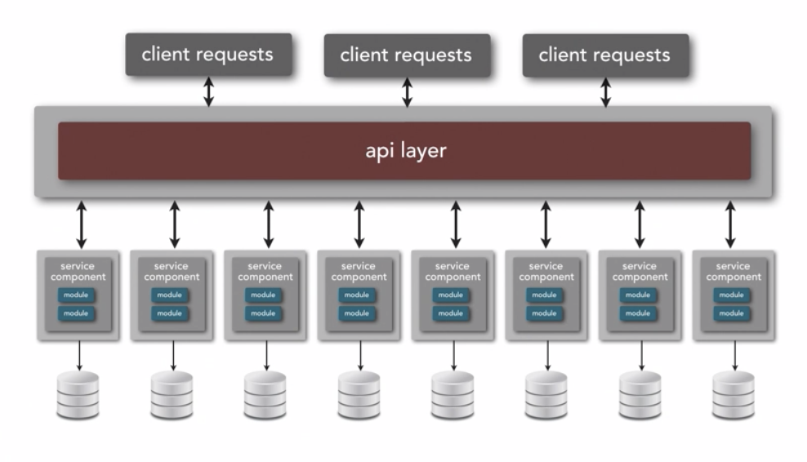
Microservice Architecture
Ref: Neil Ford & Mark Richards Software Architecture Fundamentals
Basic Idea – SHARE NOTHING

Slide 14
Ingredients needed to create applications using the SOA style
A set of services that is thought to be of value to customers, partners, or other areas of an organization
An architectural style that requires a service provider, mediation, and service requestor with a service description
A set of architectural principles, patterns and criteria that address characteristics such as modularity, encapsulation, loose coupling, separation of concerns, reuse and composability
A programming model complete with standards, tools and technologies that supports web services, REST services or other kinds of services
A middleware solution optimized for service assembly, orchestration, monitoring, and management
Adopted from: http://www-01.ibm.com/software/solutions/soa/

Slide 15
Programming Models and Considerations
Framework and Tools
Scalability
Resiliency
Programming Language Support
Programming Model
Functional versus annotation based
Type Safety
Sync- or Async-
Streaming Support

Slide 16
The SOA Samples
https://github.com/ArchitectingSoftware/cs575-soa-demo.git
Example | Framework | Notes
graphql-typescript | GraphQL | Demonstrates the use of the graphql framework for type-safe queries to services
grpc | Google – GRPC & Protocol Buff | Type safe, high performance, polyglot rpc based messaging system. Async and streaming
rest-go | Golang based framework gonic-gin | Async golang based REST Service
rest-java | Spring | Spring boot 2.0 annotation based server
rest-kotlin | Spring | Spring boot 2.0 functional based serfver – Kotlin Programming language

Slide 17
The SOA Samples
https://github.com/ArchitectingSoftware/cs575-soa-demo.git
Example | Framework | Notes
rest-ktor | Ktor | Kotlin Ktor REST Service interface, uses Kotlin Co-Routines for concurrency
rest-node-koa | Koa | Uses Koa and typescript with the latest javascript support for async/await
rest-scala | Akka Http | Async scala based REST Service – uses Akka actors
Soap-java | Spring | Spring boot SOAP Based web service

Slide 18
Tenets of SOA – Boundaries are Explicit
A boundary represents the border between the services interface and its internal private representation
Interaction via messages is used to cross well-defined boundaries
A boundary is used to abstract certain factors such as geography, trust, or execution complexity
A SOA-based design needs to account for the opaque aspects of crossing boundaries
The physical location of the service is unknown and should not matter
Security models and policies are enforced as boundaries are crossed
Marshalling and casting data structures from the services public interface to private internal representations might require additional resources
The service consumer is likely to have no knowledge of the internal service implementation and therefore has no control over certain service execution aspects such as performance
The distributed nature of crossing service boundaries introduces multiple opportunities for errors, thus error processing must be robust

Slide 19
Tenets of SOA – Services are Autonomous
Services are entities that can be independent deployed, versioned and managed
Services are dynamically addressable through a well known URI
The physical location of the service can change with the expectation of not impacting the consumer
If the service relies on another service, it should not use the service client to bridge this dependency
Both service consumers and service providers should take a pessimistic view of performance and the behavior of the other party
Service consumers should be able to time-out and appropriately deal with a slow response times
Service providers should assume that service consumers might misuse the service (accidently or maliciously) and be hardened to deal with these issues

Slide 20
Tenets of SOA – Services Share Schema and Contract, not Class
Services interaction should be based solely on the services interface contract (versions, discovery, policies, message-formats/schemas, behaviors)
Implementation details of a service (the class structure used to construct the service) are independent from the interface used to invoke the service
The key to designing good services, is designing good service interfaces
They are hard to change – may break existing service consumers
They can introduce performance challenges – transforming between the service interface and native interface can be expensive
Consumers must not only know the structural aspects of the interface but also the policies that govern the service implementation

Slide 21
Tenets of SOA – Service Compatibility is based on Policy
Service interfaces define the structural contract for interfacing with a service, policies define the semantic aspects of interacting with a service
Policies govern the behavior and expectations of a particular service, example:
Before a new user is created, the ID must be unique
Services supporting external users should be given more priority than services supporting internal applications
A secure service must adhere to a set of required security policies (e.g., OAuth, mutual auth, etc)
Messages received by a service must be encrypted in a certain way
Messages can be accepted over a queue or HTTP

Slide 22
Approaches to Identify Services in a SOA Design
1. Business Process Decomposition
Businesses can be viewed in terms of their primary processes, these processes can be further subdivided into sub-processes, and then decomposed again into very granular processes. These are typically called the L1, L2, and L3 processes
The L3 processes are “logical units of work” that support the business
Logical units of work have a clear input, output and rules that transform inputs into outputs – these can be services
Example: EnrollCustomerInLoyaltyProgram
2. Business Functions
Similar to business processes, many organizations operate using a collection of business functions
Designing around business functions are less likely to be biased by the way the business processes were implemented.
A function takes the form of y = f(x) where inputs “x” are transformed into a well defined output(s).
Example: ProcessCustomerPayment(x) applies x dollars against the customers account

Slide 23
Approaches to Identify Services in a SOA Design
3. Look for “Business Entity” Objects in the problem domain
Most SOA solutions operate on data. Objects in an OOD work at the table level
SOA components operate at the business object level
Look for key business entities in the application domain from the perspective of (C)reate, (R)ead, (U)pdate, or (D)elete operations.
Examples: Customer, Payments, Order, etc
4. Look at “Ownership and Responsibility” to leverage reusable services built by others (where it makes sense)
This SOA design attribute is less about identifying a service, and more about identifying who builds, owns and maintains the service.
Many SOA applications are “mash ups”, combining services from different parties.
When identifying a service, look for opportunities to reuse services that are offered by others when they are not key to differentiating you application.
Example: If you need a service for mapping or geo-coding would you build this yourself, or would you integrate a service offered by google?

Slide 24
Approaches to Identify Services in a SOA Design
5. Goal-Driven Service identification
Identify goals of your business or application that can be realized via automated support.
Example: Goal: “Improve customer transparency into service pricing”; Service: create an “Estimator” service that allows customer to estimate costs before they make a purchase decision
6. Component-Based
Use a traditional software engineering approach to identify services
Create a conceptual architecture view of the target application
Look for natural boundaries that adhere to the principles of maximizing cohesion and minimizing coupling.
These identify candidate components
For each candidate component see if they well defined responsibility, clear ownership, and if they can be distributed to run in different address spaces
Example: The bunch software clustering tool offers a clustering service where the modularization quality calculation is externalized as a service.

Slide 25
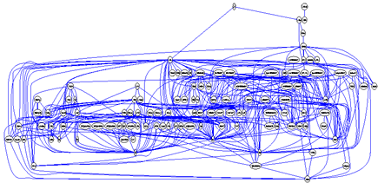
Component-Based Decomposition Example – The bunch system
Here is the module interdependencies of the bunch system. Not much is apparent…

Slide 26
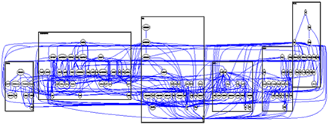
Component-Based Decomposition Example – The bunch system
Here is the module interdependencies of the bunch system. Lets run bunch itself to cluster the system to look for some candidate subsystems…

Slide 27
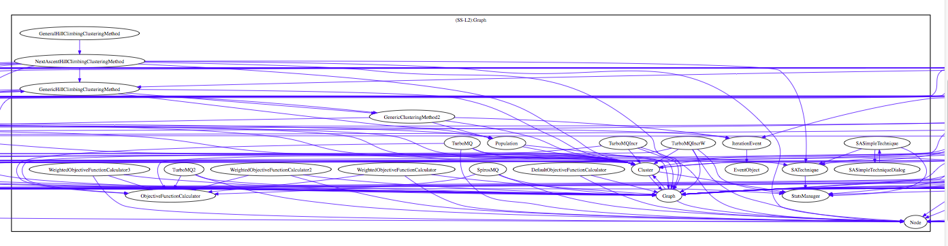
Component-Based Decomposition Example – The bunch system
This one looks promising – it has a lot of functionality related to evaluating the modularization quality function. Domain knowledge also tells us that its compute intensive so it might make for a good service…

Slide 28
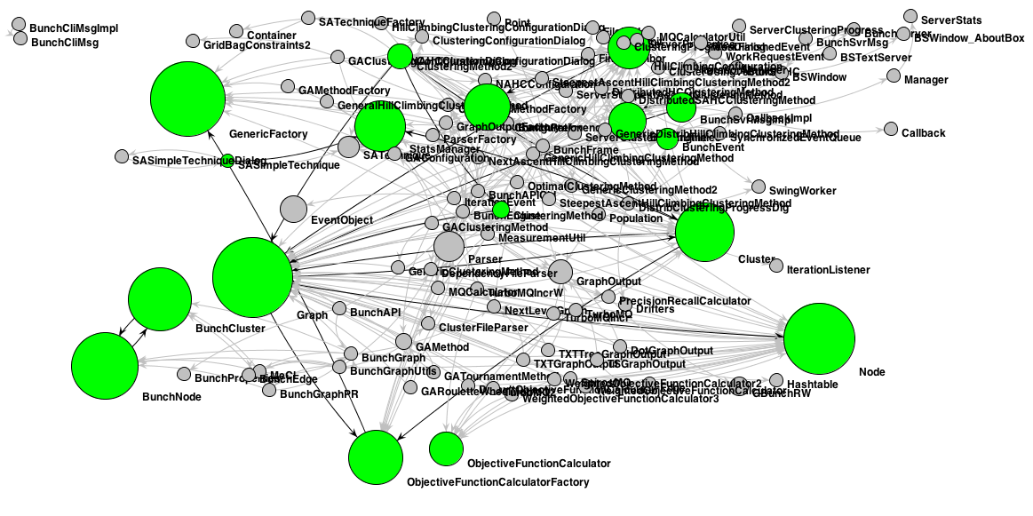
Component-Based Decomposition Example – The bunch system
This looks promising because another tool that I wrote that runs some importance algorithms identifies some of these classes as important.

Slide 29
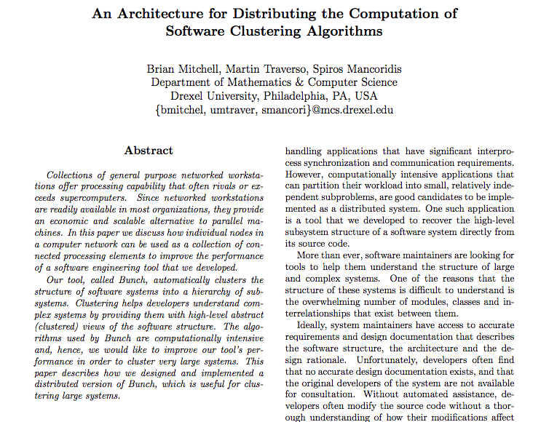
We refactored bunch to support distributed computation and describe it here…

Slide 30
Approaches to Identify Services in a SOA Design
7. Existing Supply – Refactoring into a SOA
Look at existing inventory of applications and how they work together
Identify existing integration interfaces – API calls, Database Transactions, Database Queries
Select integration points that can be migrated away from using existing integration patterns into a SOA pattern
Example: Refactor an application that supports customer service, identify all ODBC and SQL calls that related to customer management, refactor by creating a SOA service for “Customer”
8. Front Office Application Usage Analysis
Most enterprise have multiple applications that have some underlying redundant functionality – typically this functionality is implemented differently in each application.
Identify these redundant functions and see if they can be encapsulated into a common service.
Example: Drexel grading data is used by students, facility and the administration – it can be accessed via the web, but we would like to extend to mobile. Solution is to create a common grading service that can be used by multiple applications. Imagine a service like “HoldGrades()” that is called from the billing system

Slide 31
Approaches to Identify Services in a SOA Design
9. Infrastructure
Although not common, there are cases when services are useful to take advantage of sharing infrastructure-specific capabilities.
Consider that you have a special piece of hardware that performs a very specific function and you want to share that capability with a lot of consuming applications.
Consider when you need to isolate a specific function to a certain piece of hardware or network zone for compliance purposes
Create a service that hides the specifics of the special infrastructure and expose it to other applications. Example: Use PayPal’s payment services instead of doing your own credit card processing – eliminates the need to deal with PCI compliance.
10. Look at non-functional requirements.
Examine the set of non-functional requirements and look for opportunities where centralizing the implementation of certain capabilities helps enable the non-functional requirements.
Common examples are from security and performance set of non-functionals.
Example: Create a service to encapsulate making authorization decisions abstracting the complex dataflow of the oAuth protocol; another example is the distribution of the MQ calculation in the Bunch tool (from Method #6)
Reference: “Ten Ways to Identify Services”, http://searchsoa.techtarget.com/tip/Ten-ways-to-identify-services

